Slide 1
Project Presentation : Factoid Question Answer Generation from Wikipedia
Team 28 Vikrant Goyal, Eavanshi Arora, Nikita Agarwal

Slide 2
Problem Statement
In this project, we consider an automatic Sentence-to-Question-Answer generation task, where given a sentence, the Question Generation (QG) system generates a set of question answer pairs for which the sentence contains or needs answers.

Slide 3
Goals
Goal 1
Our QA generation system should only ask factoid questions i.e questions whose answer is a single entity rather than generating a opinion based question or a description based question.
Goal 2 It should be able to handle the cases of complex sentences too.

Slide 4
Tools Used
TextBlob
Nltk
Python wikipedia library (wikipedia)
Regex (re)

Slide 5
Types of Questions
Purpose - the correction of knowledge deficits , the monitoring of common ground
Type of Information - concept completion questions, “shallow” factual questions
Source of Information - aims to generate questions for which the source of answer is the literal information in the text
Length of the Expected Answer - short, usually a single word or short phrase

Slide 6
Process Followed
Extracting wikipedia articles from the wikipedia library in python and then running a tokenizer on it.
We have taken only the summary of the articles because it’s the only content that is quite useful and would generate good questions.
Used inbuilt POS tagger for tagging the corpus.
Now we need to extract the named entities and classify them too. But the inbuilt NER tagger is quite bad as we have experimented on it.

Slide 7
Process Followed
So we wrote our own grammar for the nltk chunker and parsed each sentence.
Now extract the essential named entities from each sentence and classify them as location, proper noun and some kind of number or date.
Based on the above classification we can get the type of question namely where, who, which etc.

Slide 8
Problems Faced
Challenge 1
Semantics of the answer to a question affects the question’s form. Mapping answers to “Wh” words and phrases such as who or which is difficult.
Challenge 2
Non-compositionality : A phrase is not just a simple aggregation of the meaning of it’s component words. So it can be misleading. Example : burned to the ground

Slide 9
Milestones Achieved
Questions of the form - Fill In The Blanks.
Fill in the blanks type of questions are also quite important and have its applications in the education assessment. We have successfully generated questions of the above mentioned format which are very accurate and can easily deal complex sentences.

Slide 10
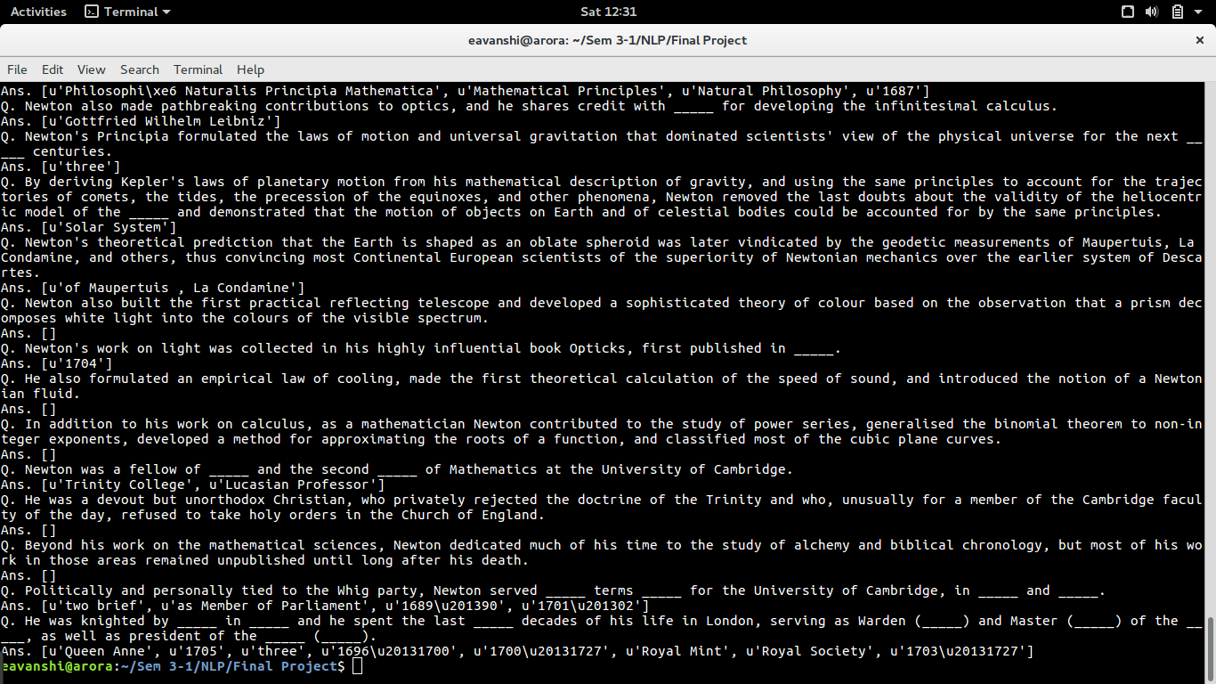

Slide 11
Milestones Achieved
2. Normal QA system for simple questions
We have also made a system which can give out the normal type of questions and would be better only on the simple sentences. It can’t handle the case of complex sentences as it would require quite good parsing techniques and extraction of certain clauses from a sentence.

Slide 12
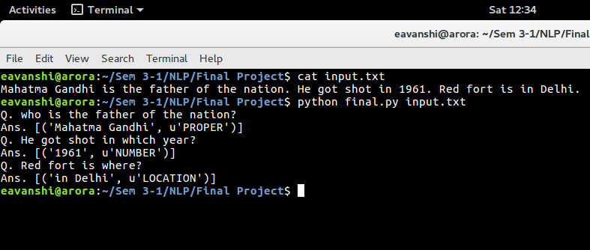

Slide 13
Further Research
Major improvement that can be done is to generate question for Complex sentences, which requires appropriate shallow parsing of text so that we can extract simple sentences or clauses from the sentences for which our system can generate questions easily. Some kind of discourse parsing might also help.

